Slide 1
COVID-19 Pandemic Update
28 July 2020

Slide 2
Outline
Introduction
Global SitRep
Local SitRep
Public Health Measures
Subcommittee Updates

Slide 3
Introduction
Coronavirus Disease (COVID-19) caused by Severe Acute Respiratory Syndrome Coronavirus 2 (SARS-CoV-2) alerted on 31 December 2019
Zoonotic, transmission, signs and symptoms
Declared Public Health Emergency of International Concern(PHEIC) on 30 January 2020
Declared Pandemic on 11 March 2020
Declared State of Disaster in Malawi 20 March 2020
First confirmed case of COVID-19 in Malawi on 2nd April 2020

Slide 4
Cumulative Cases and CFR as of 27th July 2020
WHO Region | Cumulative Cases | Cumulative Deaths | Case Fatality Rate(%)
Global | 16 114 449 | 646 641 | 4.0
Africa | 712 920 | 11 900 | 1.7
Americas | 8 610 134 | 337 439 | 3.9
Eastern Mediterranean | 1 482 315 | 37 932 | 2.6
Europe | 3 234 043 | 210 518 | 6.5
South East Asia | 1 786 145 | 40 615 | 2.3
Western Pacific | 288 151 | 8 224 | 2.9

Slide 5
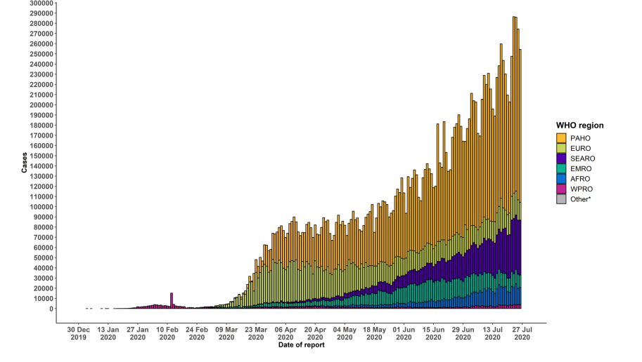
Global Epidemiological Curve through 27 July
Notes:
Data from USA was not received by the cutoff time hence the drop in the PAHO region. Will be adjusted accordingly when data is made available

Slide 6
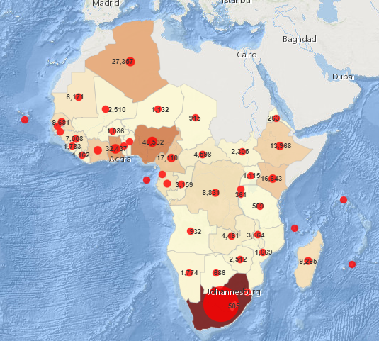
Africa COVID-19 Cases as of 27 July 2020

Slide 7
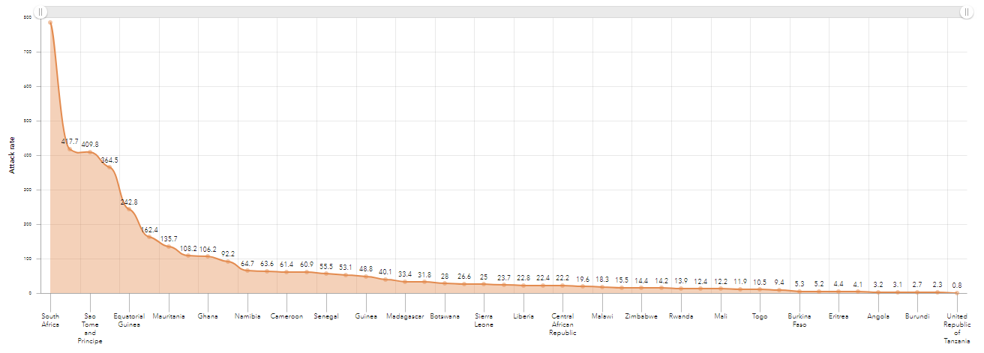
COVID-19 Attack Rate WHO AFRO as of 27th July 2020

Slide 8
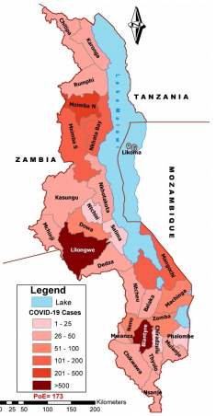
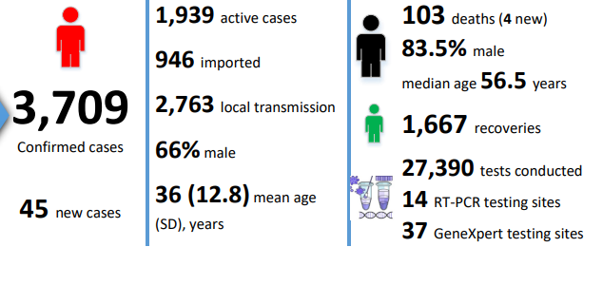
Local Situation Update as of 27th July 2020
Notes:
Mean age has slightly increased to 35 from 33(still within SD though)
Both Ntchisi and Likoma have reported 1 case each, now all 29 health districts have confirmed cases and are testing

Slide 9
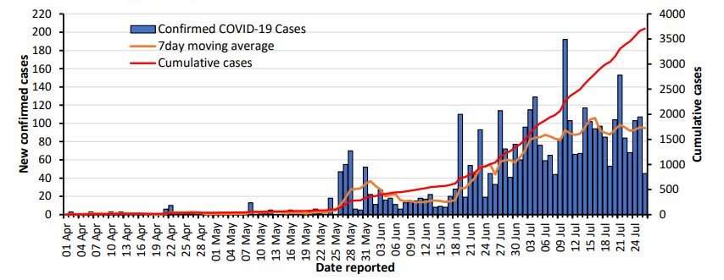
COVID-19 cases in Malawi as of 27th July 2020
Notes:
Epi curve

Slide 10
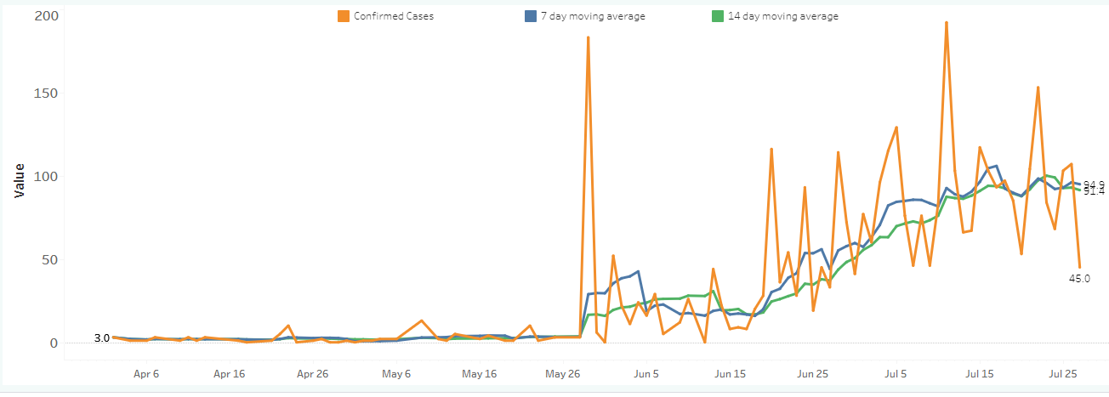
Epi Curve Moving Average through to 28 July

Slide 11
COVID-19 cases in Malawi as of 26 July 2020

Slide 12
COVID-19 Attack Rate per 10,000 in Malawi by District as of 27th July

Slide 13
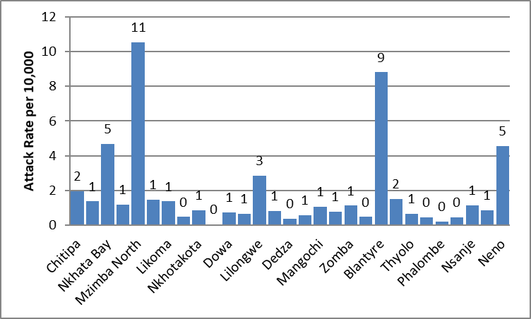
COVID-19 Attack Rate per 10,000 in Malawi by District as of 27th July

Slide 14
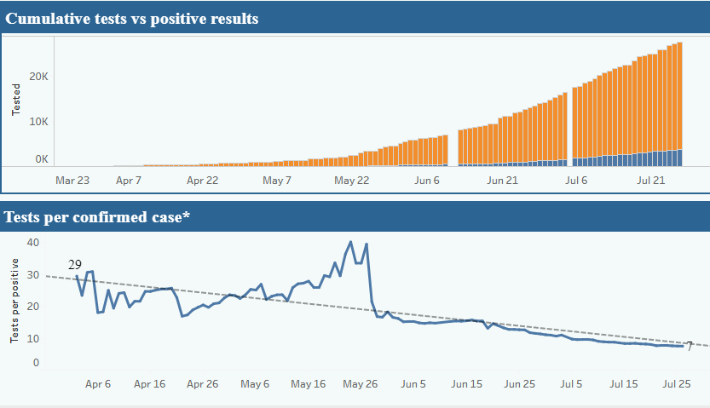
COVID-19 Positive Rate as of 27 July – 13.54%
Notes:
WHO general benchmark of adequate testing is 3-12%
10-30 tests per confirmed case as recommendation

Slide 15
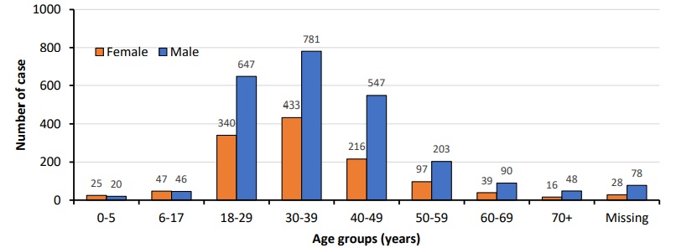
Age Distribution of COVID-19 Cases 27th July 2020

Slide 16
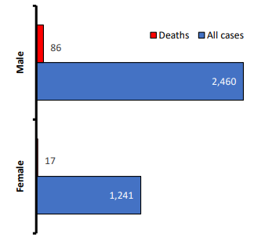
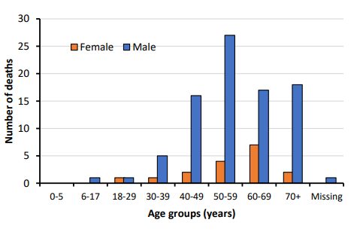
COVID-19 Death Characteristics as of 27th July
CFR Male 3.5% Female 1.4%
Median age 56.5
Notes:
Median Age 56 (Range 26 to 82)
Clinical Case Management auditing- info on comorbidities
Combined CFR 2.8%

Slide 17
Health Care Workers
327Health Workers
24 Districts Affected
Mostly High burden districts
Median Age 35(Range 17 to 72)

Slide 21
Public Health Measures
Testing – Focused
Tracing - Identification and follow up of the contacts
Isolating – Advice on isolation for contacts
Infection prevention and control in health care settings and Community-mandatory masking, PPE availability for HCWs
Implementation of health measures for travelers
Awareness-raising in the population – how best to utilize influencers
Risk communication – best community engagement strategies
-to find, isolate, test and care for cases;
and trace and quarantine their contacts.“Where these measures are followed, cases go down. Where
they’re not, cases go up”.- Dr Tedros

Slide 22
Coordination Update
Daily EOC Meetings
IMS Operators and Triage Manager Recruitment
Logistical support for Operations i.e. Airtime
Response Plan Review
Revision of Guidelines

Slide 23
Surveillance Updates
Back Data entry exercise at PoEs
Contact Tracing Training for CHWs- field test
Daily Surveillance subcommittee meetings
Reception of Returnees
Production of Daily Situation Reports
Local Data Modelling -Reproductive number, Severity trajectory
Notes:
No Update on Syndrommic, Sentinel, FFX, KAP survey, Seroprevalence

Slide 24
Challenges
Data Management- Completeness and Timeliness
Data flow from Lab to Surveillance, Central Hospitals to Districts
Logistical Support for RRT operations

Slide 25
THANK YOU

