Slide 1
Sdg 6 targets and indicators tracking
Presented for wesnet at ekwendeni
By: Jeremiah Sakala
26TH February 2020

Slide 2
Overview - The political process
2012: The Future we Want (Rio+20)
2015: Sustainable Development Goals
2002: World Summit on Sustainable Development
1992: Agenda 21 (Rio)

Slide 3
Millennium development goals
- The Millennium Development Goals (MDGs) were the eight international development goals for the year 2015 that had been established following the Millennium Summit of the United Nations in 2000, following the adoption of the United Nations Millennium Declaration. All 189 United Nations member states at the time (there are 193 currently), and at least 23 international organizations, committed to help achieve the following Millennium Development Goals by 2015:
1) To eradicate extreme poverty and hunger
2) To achieve universal primary education
3) To promote gender equality and empower women
4) To reduce child mortality
5) To improve maternal health
6) To combat HIV/AIDS, malaria, and other diseases
7) To ensure environmental sustainability
8) To develop a global partnership for development

Slide 4
Sustainable development goals
- At the United Nations Sustainable Development Summit on 25/09/15, world leaders adopted the 2030 Agenda for Sustainable Development, which includes a set of 17 Sustainable Development Goals (SDGs) to end poverty, fight inequality and injustice, and tackle climate change by 2030.
Sustainable Development Goals(SDGs)
Goal 1 | End poverty in all its forms everywhere | Goal 10 | Reduce inequality within and among countries
Goal 2 | End hunger, achieve food security and improved nutrition and promote sustainable agriculture | Goal 11 | Make cities and human settlements inclusive, safe, resilient and sustainable
Goal 3 | Ensure healthy lives and promote well-being for all at all ages | Goal 12 | Ensure sustainable consumption and production patterns
Goal 4 | Ensure inclusive and equitable quality education and promote lifelong learning opportunities for all | Goal 13 | Take urgent action to combat climate change and its impacts
Goal 5 | Achieve gender equality and empower all women and girls | Goal 14 | Conserve and sustainably use the oceans, seas and marine resources for sustainable development
Goal 6 | Ensure availability and sustainable management of water and sanitation for all (6.a, 6.b) | Goal 15 | Protect, restore and promote sustainable use of terrestrial ecosystems, sustainably manage forests, combat desertification, and halt and reverse land degradation and halt biodiversity loss
Goal 7 | Ensure access to affordable, reliable, sustainable and modern energy for all | Goal 16 | Promote peaceful and inclusive societies for sustainable development, provide access to justice for all and build effective, accountable and inclusive institutions at all levels
Goal 8 | Promote sustained, inclusive and sustainable economic growth, full and productive employment and decent work for all | Goal 17 | Strengthen the means of implementation and revitalize the global partnership for sustainable development
Goal 9 | Build resilient infrastructure, promote inclusive and sustainable industrialization and foster innovation

Slide 5
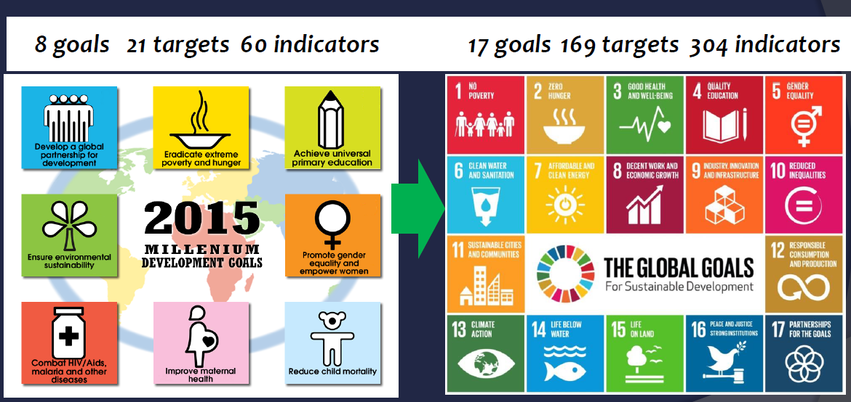
Mdg & sdg comparison

Slide 6
Mdg & sdg comparison
MDG | SDG
Traditional assistance | Traditional assistance + Universal goals
Limited goals | More comprehensive
Top-down process | Inclusive goal setting
Traditional statistics | Traditional + Data revolution
Hunger and poverty together | Distinction
Quantity Education | Quality Education
Funding: Focus on ODA | Broader set of financial sources

Slide 7
Mdg & sdg comparison

Slide 8
Sdg #6
Target | Indicator
6.1 By 2030, achieve universal and equitable access to safe and affordable drinking water for all | 6.1.1 Proportion of population using safely managed drinking water services
6.2 By 2030, achieve access to adequate and equitable sanitation and hygiene for all and end open defecation, paying special attention to the needs of women and girls and those in vulnerable situations | 6.2.1 Proportion of population using safely managed sanitation services, including a hand-washing facility with soap and water
6.3 By 2030, improve water quality by reducing pollution, eliminating dumping and minimizing release of hazardous chemicals and materials, halving the proportion of untreated wastewater and substantially increasing recycling and safe reuse globally | 6.3.1 Proportion of wastewater safely treated 6.3.2 Proportion of bodies of water with good ambient water quality

Slide 9
Sdg #6 cONT….
Target | Indicator
6.4 By 2030, substantially increase water-use efficiency across all sectors and ensure sustainable withdrawals and supply of freshwater to address water scarcity and substantially reduce the number of people suffering from water scarcity | 6.4.1 Change in water-use efficiency over time 6.4.2 Level of water stress: freshwater withdrawal as a proportion of available freshwater resources
6.5 By 2030, implement integrated water resources management at all levels, including through transboundary cooperation as appropriate | 6.5.1 Degree of integrated water resources management implementation (0–100) 6.5.2 Proportion of transboundary basin area with an operational arrangement for water cooperation
6.6 By 2020, protect and restore water-related ecosystems, including mountains, forests, wetlands, rivers, aquifers and lakes | 6.6.1 Change in the extent of water-related ecosystems over time

Slide 10
Sdg #6 cont….
Target | Indicator
6.a By 2030, expand international cooperation and capacity-building support to developing countries in water and sanitation-related activities and programmes, including water harvesting, desalination, water efficiency, wastewater treatment, recycling and reuse technologies | 6.a.1 Amount of water- and sanitation-related official development assistance that is part of a government coordinated spending plan
6.b Support and strengthen the participation of local communities in improving water and sanitation management | 6.b.1 Proportion of local administrative units with established and operational policies and procedures for participation of local communities in water and sanitation management

Slide 11
Indicator determination – example; sdg 6.4
$$Indicator 6.4.1=\frac{total water use}{value of economic output}$$
$$Indicator 6.4.2=\frac{Total Water Withdrawal}{Total Renwewable Water Resources}$$

Slide 12
The challenge ahead
Need to Focus on quality not quantity
Requires Higher standards for programming
Requires Increased focus on institutions –Schools and health facilities
Increased need for accurate designing, monitoring and evaluation. More indicators, rigorous requirements and disaggregated information.

Slide 15
Thank you

