Slide 1
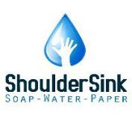
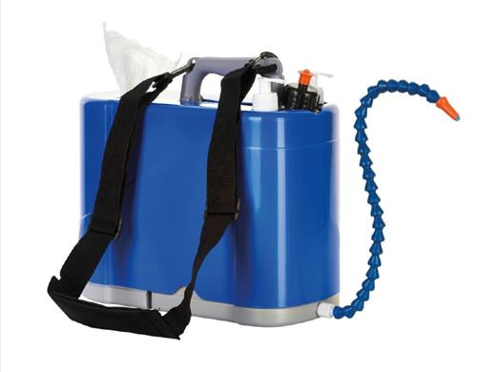
ShoulderSink
Water –Soap and Sanitizer Right at Hand

Slide 2
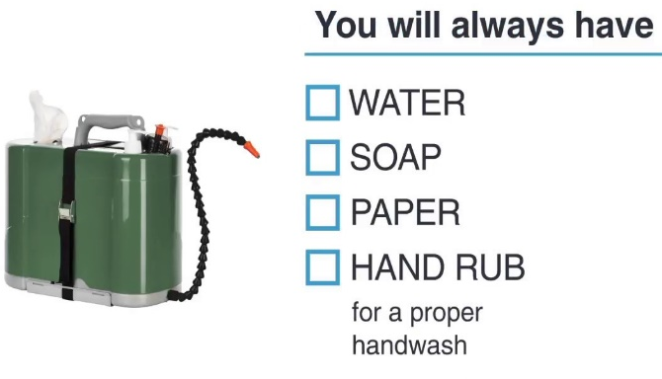
What is the ShoulderSink
The ShoulderSink is a mobile hygiene station that gives the user access to a hand wash wherever and whenever needed. A unit is typically packed with water, soap, hand rub but other products can be fitted as needed.
Water and soap/hand cleanser is the best way to clean dirty hands before using other products such as hand rub. Both the CDC and WHO recommend using soap and water beforehand rubs when you have visibly dirty hands.

Slide 3
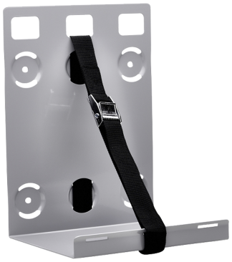
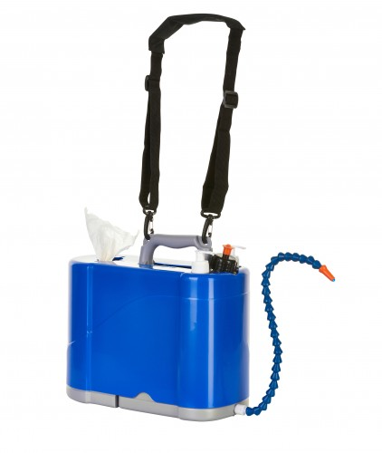
FEATURES

Slide 4
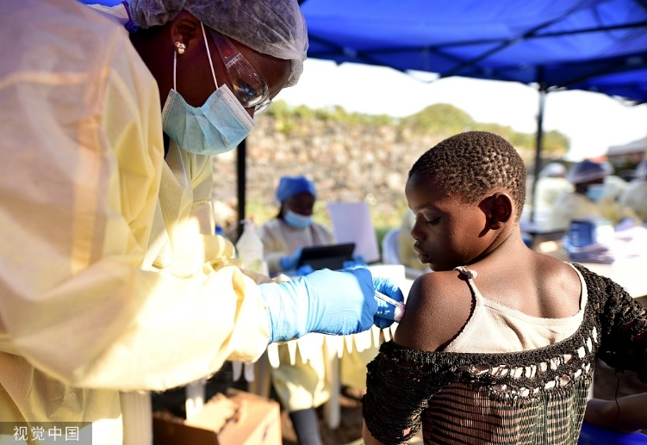
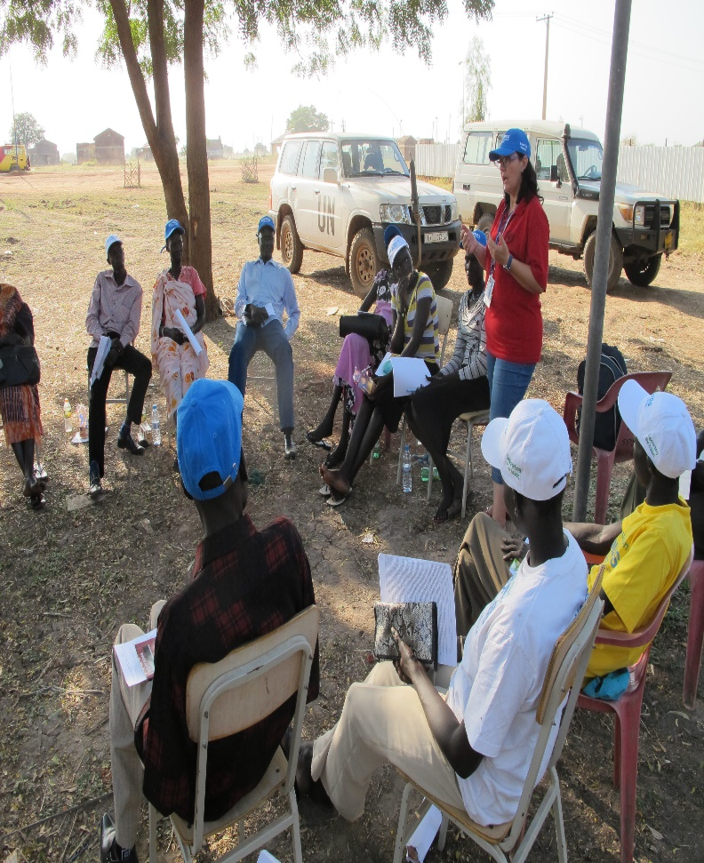
Use Applications
Health care workers
Teachers
Soldiers
Engineers
Farmers
Parents
Anyone on the move, in communities, rural areas and areas or places where water is not readily available.

